Slide 1
Week # 9 incuding Lab # 6 slides
MPI syllabus as per course outline

Slide 2
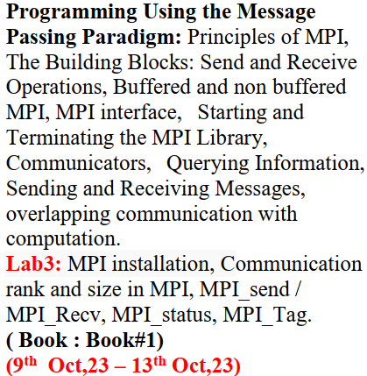
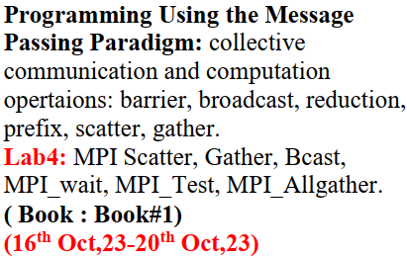
MPI Syllabus (as per Course outline)

Slide 3
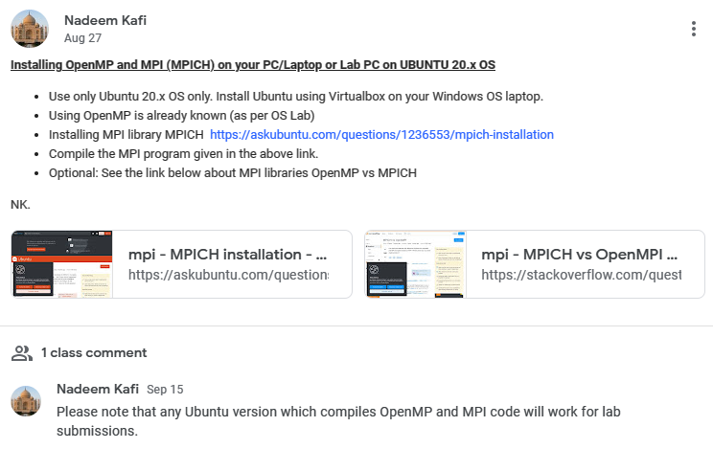
Show it to your TA at the time of Semester Project DEMO

Slide 4
Programming Models
Serial Programming
Message-Passing Parallel Programming
Concepts
Array Subroutines
Control Flow
Variables OO Human-readable
Concepts
Processes Send/ Receive
SPMD Collectives Groups
Languages
Python Java C++/ C Fortran
Struct if/then/else
Libraries
MPI MPI_Init()
Implementation
gcc –O3 pgcc –fast icc
Crayftn javac craycc
Implementation
Intel MPI MPICH2 OpenMPI CrayMPI IBM MPI

Slide 5
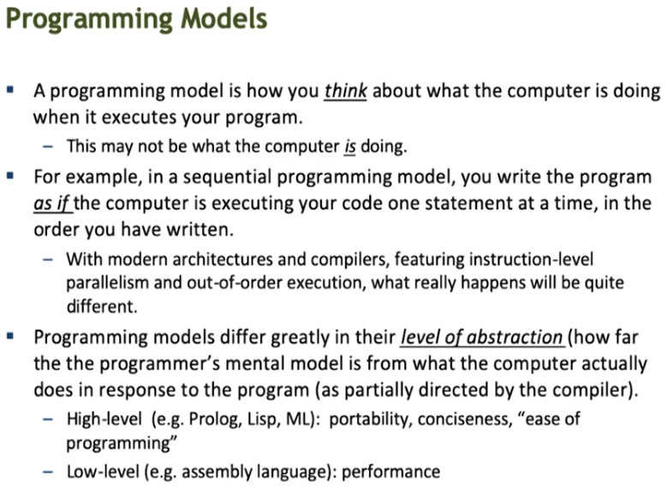

Slide 6
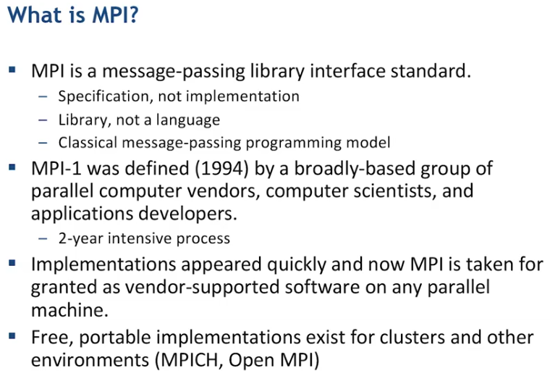

Slide 7
Message Passing Models
The message passing model is based on the notion of processes
Can think of a processes as an instance of a running program, together with the program’s data.
In the message passing mode, parallelism is achieved by having many processes co-operate on the same task
Each process has access only to its own data.
i.e. all variables are private.
Processes communicate with each other by sending and receiving messages.
Typically library calls from a conventional sequential language.

Slide 8
Sequential Paradigm Parallel Paradigm
Memory
M
Process
0
1
2
3
Message Passing Interface
P
Processor
COMMUNICTION NETWORK

Slide 9
Distributed Memory Architecture
P
M
P
M
P
M
P
M
Interconnect
P
M
P
M
P
M
P
M

Slide 10
Starting and Terminating the MPI Library
MPI_Init is called prior to any calls to other MPI routines. Its purpose is to initialize the MPI environment.
MPI_Finalize is called at the end of the computation, and it performs various clean-up tasks to terminate the MPI environment.
The prototypes of these two functions are:
int MPI_Init(int *argc, char ***argv)
int MPI_Finalize()
MPI_Init also strips off any MPI related command-line arguments.
All MPI routines, data-types, and constants are prefixed by “MPI_”. The return code for successful completion is MPI_SUCCESS.

Slide 11
Communicators
A communicator defines a communication domain - a set of processes that are allowed to communicate with each other.
Information about communication domains is stored in variables of type MPI_Comm.
Communicators are used as arguments to all message transfer MPI routines.
A process can belong to many different (possibly overlapping) communication domains.
MPI defines a default communicator called MPI_COMM_WORLD which includes all the processes.

Slide 12
Querying Information
The MPI_Comm_size and MPI_Comm_rank functions are used to determine the number of processes and the label of the calling process, respectively.
The calling sequences of these routines are as follows:
int MPI_Comm_size(MPI_Comm comm, int *size)
int MPI_Comm_rank(MPI_Comm comm, int *rank)
The rank of a process is an integer that ranges from zero up to the size of the communicator minus one.

Slide 13
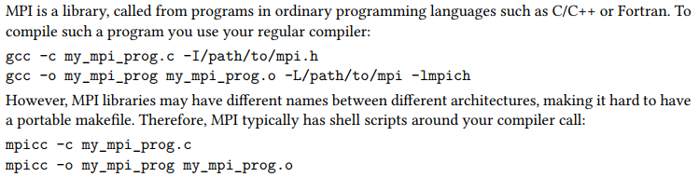
How to Compile and run MPI Programs

Slide 14
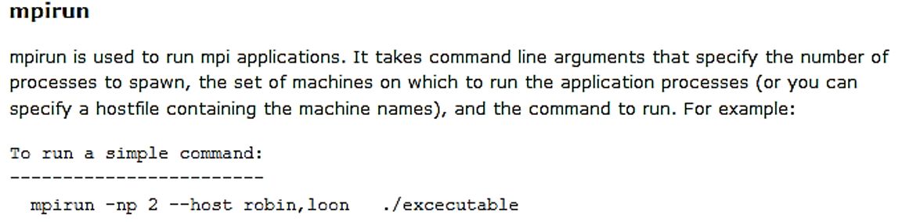
How to Compile and run MPI Programs

Slide 15
Sending and Receiving Messages
The calling sequences of these routines are as follows:
int MPI_Send(void *buf, int count, MPI_Datatype datatype, int dest, int tag, MPI_Comm comm)
Input Parameters:
Buf : initial address of send buffer (choice)
Count: number of elements in send buffer (nonnegative integer)
Datatype : datatype of each send buffer element (handle)
Dest : rank of destination (integer)
Tag: message tag (integer)
Comm : communicator (handle)

Slide 16
Sending and Receiving Messages
int MPI_Recv(void *buf, int count, MPI_Datatype datatype, int source, int tag, MPI_Comm comm, MPI_Status *status)
Output Parameters:
Buf : initial address of receive buffer (choice)
Status : status object (Status)
Input Parameters :
Count : maximum number of elements in receive buffer (integer)
Datatype : datatype of each receive buffer element (handle)
Source: rank of source (integer)
Tag: message tag (integer)
Comm: communicator (handle)

Slide 17
MPI Datatypes
MPI Datatype | C Datatype
MPI_CHAR | signed char
MPI_SHORT | signed short int
MPI_INT | signed int
MPI_LONG | signed long int
MPI_UNSIGNED_CHAR | unsigned char
MPI_UNSIGNED_SHORT | unsigned short int
MPI_UNSIGNED | unsigned int
MPI_UNSIGNED_LONG | unsigned long int
MPI_FLOAT | float
MPI_DOUBLE | double
MPI_LONG_DOUBLE | long double
MPI_BYTE
MPI_PACKED

Slide 18
Sending and Receiving Messages
MPI allows specification of wildcard arguments for both source and tag.
If source is set to MPI_ANY_SOURCE, then any process of the communication domain can be the source of the message.
If tag is set to MPI_ANY_TAG, then messages with any tag are accepted.
On the receive side, the message must be of length equal to or less than the length field specified.

Slide 19
Sending and Receiving Messages
On the receiving end, the status variable can be used to get information about the MPI_Recv operation.
The corresponding data structure contains:
typedef struct MPI_Status {
int MPI_SOURCE;
int MPI_TAG;
int MPI_ERROR; };
The MPI_Get_count function returns the precise count of data items received.
int MPI_Get_count(MPI_Status *status, MPI_Datatype datatype, int *count)

Slide 20
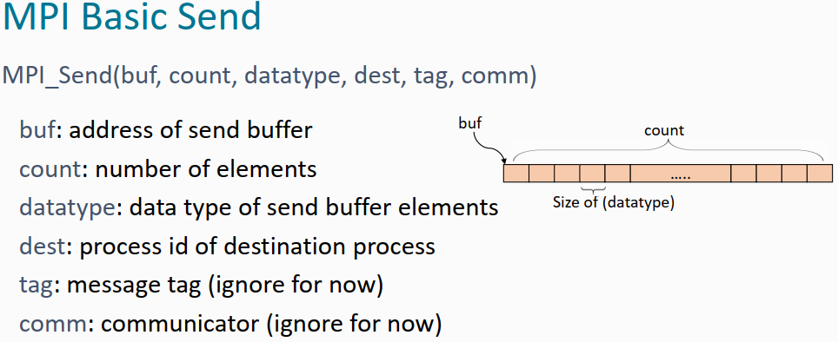

Slide 21
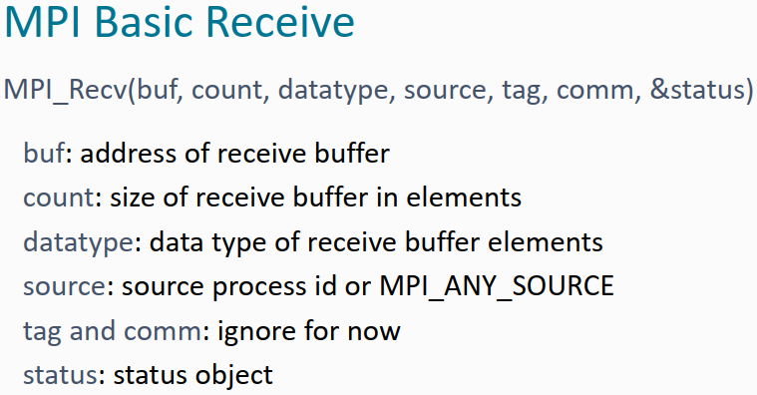

Slide 22
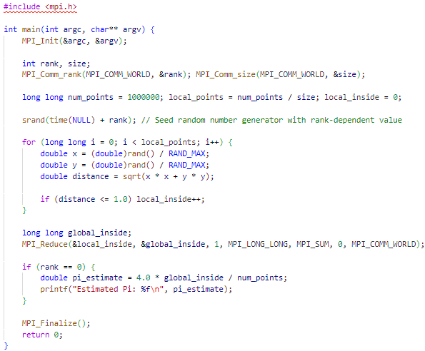
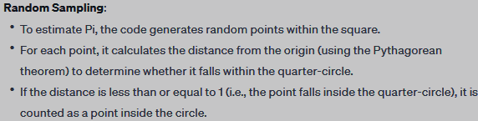
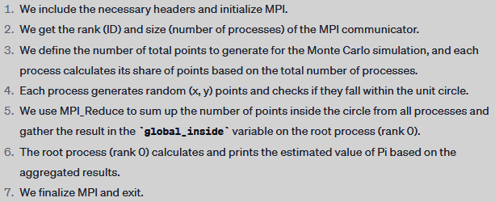

Slide 24
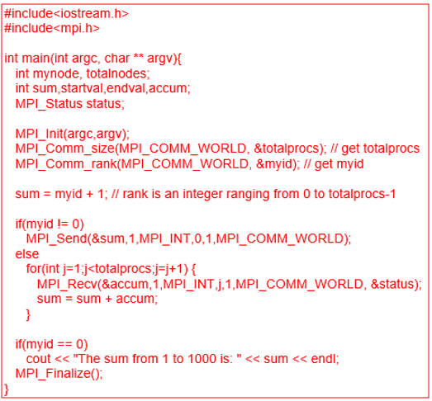
Write compact readable MPI C code to sum up all the numbers from 1 to 1000.
Use 1000 processes, where process 0 will print the sum. Note:
Explain all MPI functions after the code. Ensure that your code computes the correct sum.

Slide 25
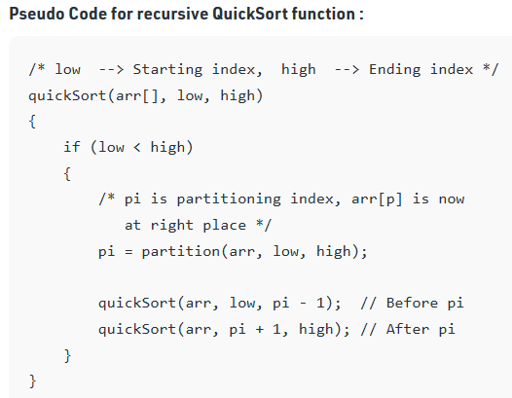

Slide 26
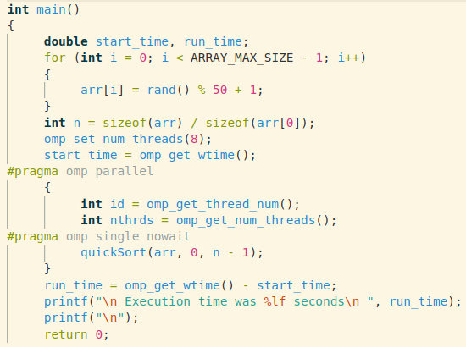
Parallel version of Recursive Quicksort

Slide 27
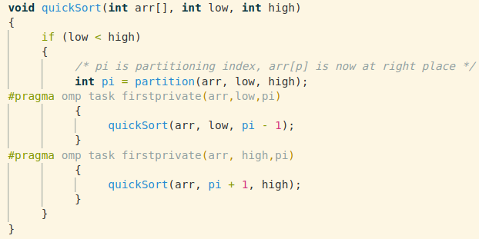
Parallel version of Recursive Quicksort

Slide 28
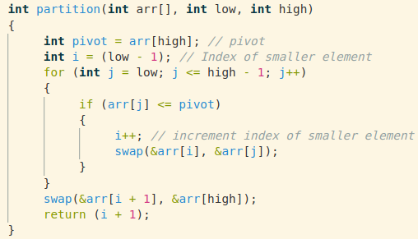
Partition function of Quicksort

Slide 29
Distributed System
The logical view of a machine supporting the message-passing paradigm consists of p processes, each with its own exclusive address space.
Instances of such a view come naturally from clustered workstations and non-shared address space multi-computers.
Message-passing programming paradigm.
Two Key attributes
Partitioned Address Space
No directly access to memory attached to each processor
Explicit Parallelism
concurrent computations by means of primitives in the form of special-purpose directives or function calls.

Slide 30
Partitioned Address Space
Each data element must belong to one of the partitions of the space; hence, data must be explicitly partitioned and placed.
Programming complexity as data need to be send and received across the network instead of read/write data to memory. Need faster networks and efficient network resources to move large amount of data.
Faster access to local data helps achieve high performance on non-UMA architecture.
Access to remote computations neeed.
All interactions (read-only or read/write) require cooperation of two processes – the process that has the data and the process that wants to access the data.
Code complexity as data process does not know of events at requesting processes.
Programmer has knowledge of all interactions and can think about algorithms (and mappings) that minimize interactions.
Scalable to very large number of processors 100K+ and 200K+ cores.

Slide 31
Message-passing programming paradigm
Parallelism is coded explicitly by the programmer.
Programmer identifies ways to decompose computations and extract concurrency.
Message-passing paradigm tends to be hard and intellectually demanding.
Potential of achieving very high performance by scaling to a very large number of processes on large infrastructures.
Asynchronous or loosely synchronous programming paradigms.
In the asynchronous paradigm, all concurrent tasks execute asynchronously.
In Loosely synchronous programs tasks execute completely asynchronously but synchronize to perform interactions.

Slide 32
Message-passing programming paradigm
Message-passing programs are written using the single program multiple data (SPMD) approach.
SPMD code executed by different processes is identical except for a small number of processes.
SPMD programs can be loosely synchronous or completely asynchronous.
Processes interact by sending and receiving messages. Two primitives are available:
send(void *sendbuf, int nelems, int dest)
receive(void *recvbuf, int nelems, int source)

Slide 33
Send and Receive Operations
Undesirable side-effects of Communication hardware
DMA and Asynchronous Communication
Blocking Message Passing Operations
Buffered and Non-Buffered
Operations Details
Idling and Deadlock
Impact of Finite Buffered
Non-Blocking Message Passing Operations
Buffered non-blocking operations
Non-buffered
MPI Offered both Buffered and Non-Buffered Operations

Slide 35
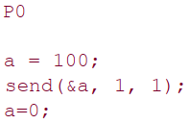
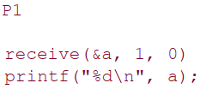
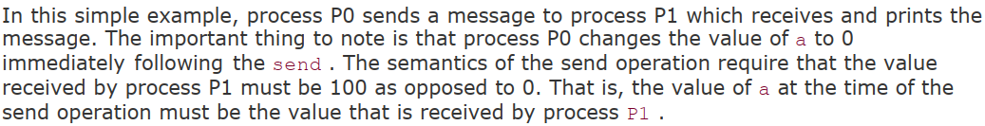

Slide 36
Undesirable side-effects of Communication hardware
Most message passing platforms have additional hardware support for sending and receiving messages.
DMA (direct memory access) and
DMA allows copying of data from one memory location to another (e.g., communication buffers) without CPU support
Asynchronous message transfer
Protocol(s) to transfer message between sender and receiver
Performance of communication processing has greatly increased using DMA and Asynchronous message transfer.
However, some undesirable side effects could be:
if the send operation programs the communication hardware and returns before the communication operation has been accomplished, process P1 might receive the value 0 in the variable “a” instead of 100!

Slide 37
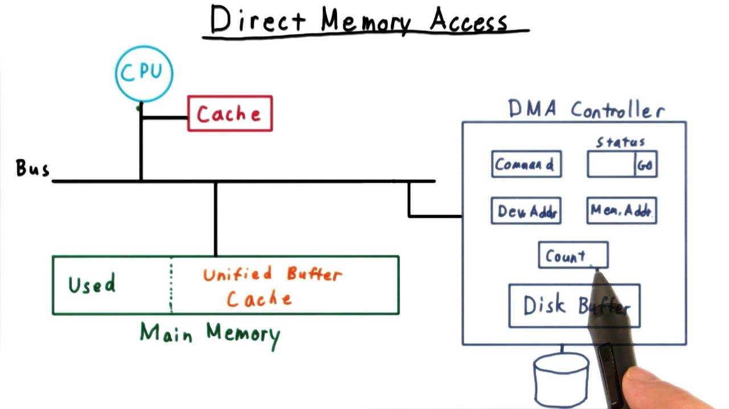

Slide 38
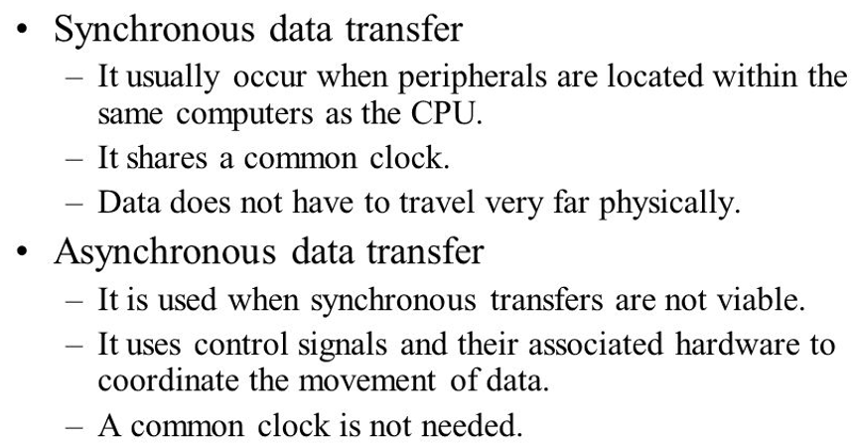
Synchronous vs Asynchronous Data Transfer

Slide 39
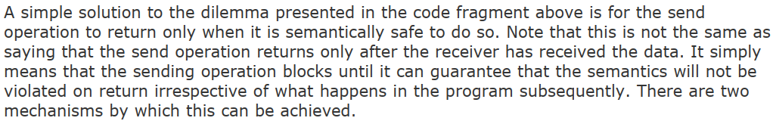

Control is returned to the calling program only when receiver has completely received the sent data.
Control is returned to the calling program after copying the data into the buffer. Transfer of data to the sender will be done asynchronously.

Slide 40
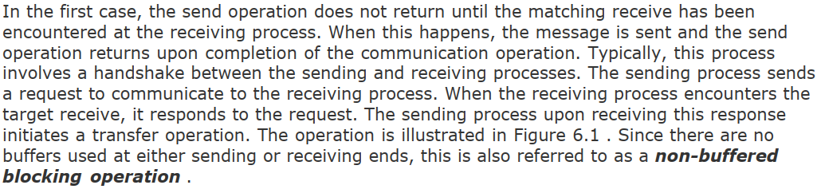

Slide 41
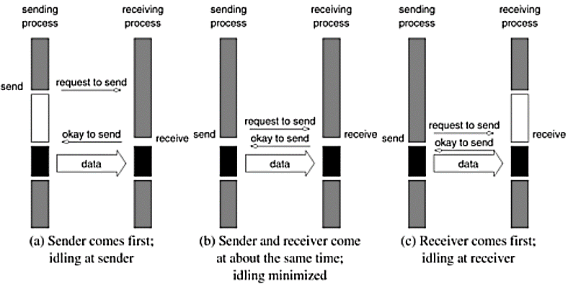


Slide 42
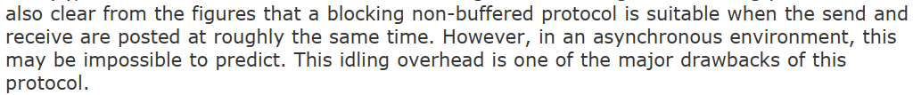
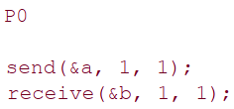
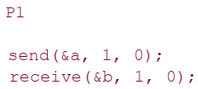
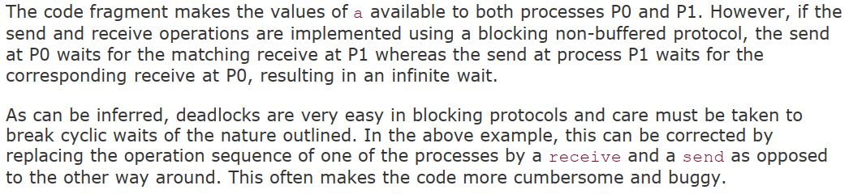

Slide 43
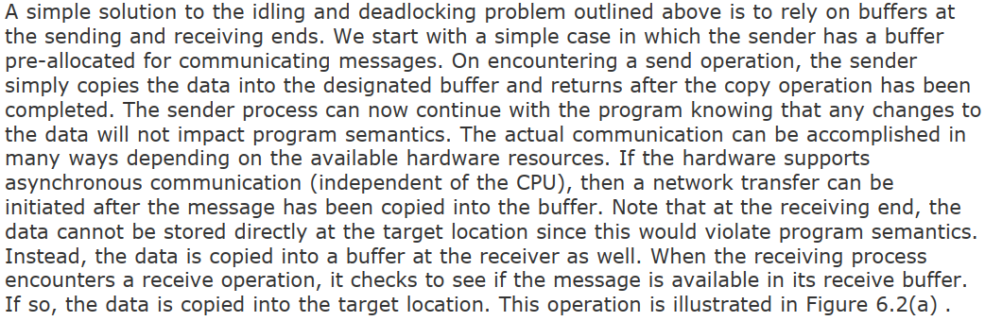

Slide 44
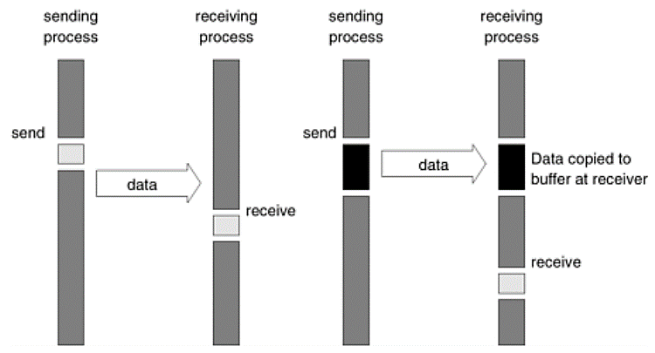
(a)
(b)
(a) in the presence of communication hardware with buffers at send and receive ends; and (b) in the absence of communication hardware, sender interrupts receiver and deposits data in buffer at receiver end. When the receiver eventually encounters a receive operation, the message is copied from the buffer into the target location.

Slide 45
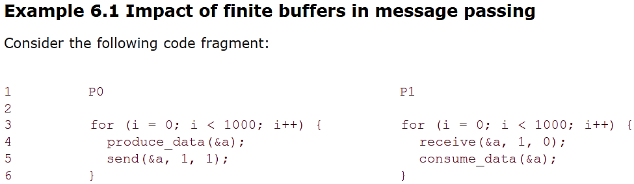
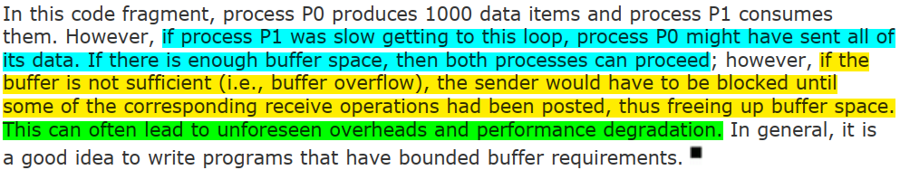

Slide 46
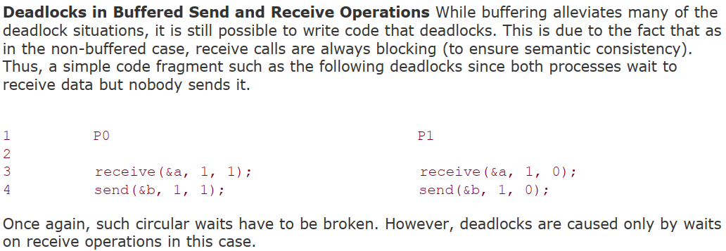

Slide 47
Non-blocking protocols returns from the send or receive operation before it is semantically safe to do so. Therefore, the user must be careful not to alter data that may be potentially participating in a communication operation.
Non-blocking operations are generally accompanied by a check-status operation, which indicates whether the semantics of a previously initiated transfer may be violated or not.
Upon return from a non-blocking send or receive operation, the process is free to perform any computation that does not depend upon the completion of the operation.
Later in the program, the process can check whether or not the non-blocking operation has completed, and, if necessary, wait for its completion.

Slide 48
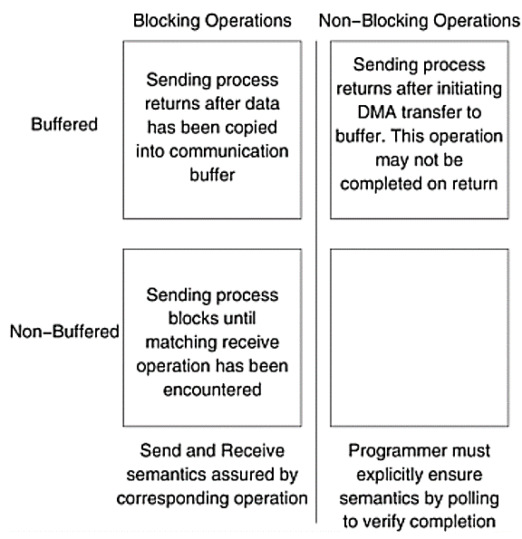


Slide 49
Buffered or Non-buffered non-blocking operations
In the buffered case, the sender initiates a DMA operation and returns immediately.
The data becomes safe the moment the DMA operation has been completed.
At the receiving end, the receive operation initiates a transfer from the sender's buffer to the receiver's target location.
Using buffers with non-blocking operation has the effect of reducing the time during which the data is unsafe.
In the non-buffered case, a process wishing to send data to another simply posts a pending message and returns to the user program.
The program can then do other useful work.
At some point in the future, when the corresponding receive is posted, the communication operation is initiated.
When this operation is completed, the check-status operation indicates that it is safe for the programmer to touch this data.

Slide 50
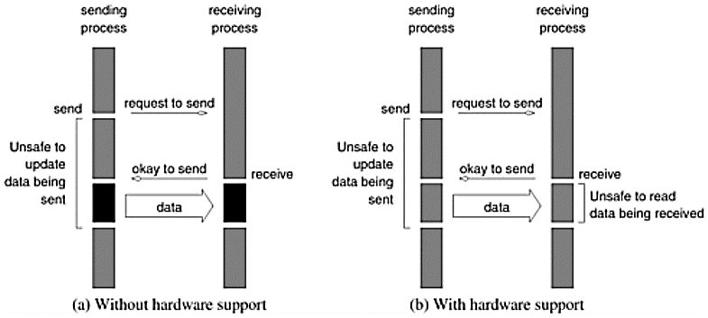

Slide 51
Using Blocking and Non-Blocking Operations
Typical message-passing libraries such as Message Passing Interface (MPI) implement both blocking and non-blocking operations.
Blocking operations facilitate safe and easier programming and non-blocking operations are useful for performance optimization by masking communication overhead.
One must, however, be careful using non-blocking protocols since errors can result from unsafe access to data that is in the process of being communicated

Slide 52
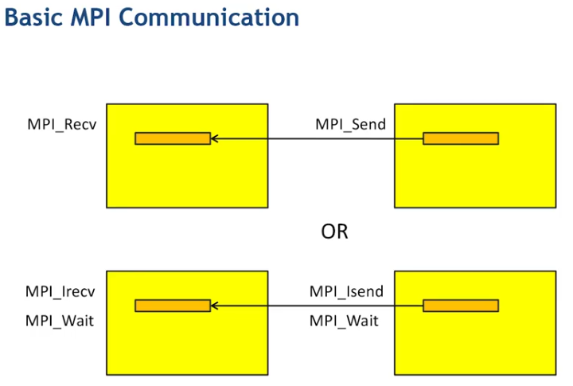
MPI_Test

Slide 53
Non-Blocking Send/Receive (Use of checking directive like MPI_Test)
Programming Models
MPI: Message Passing Interface
Minimal set of MPI routines
Starting and Terminating the MPI Library
Communicators
Querying Size of Communicators and Rank of Process
Basic MPI Program
How to Compile and run MPI Programs?
MPI_Send and MPI_Receive directives.
MPI Datatypes
MPI Program for Calculating value of PI
Install MPI on Linux VM and compile and run PI program
How MapReduce orchestrate a submitted program with the help of distributed file system? (Assignment # 2)

Slide 54
Non-Blocking Message Passing Operations
The programmer must ensure semantics of the send and receive.
This class of non-blocking protocols returns from the send or receive operation before it is semantically safe to do so.
Non-blocking operations are generally accompanied by a check-status operation.
When used correctly, these primitives are capable of overlapping communication overheads with useful computations.
Message passing libraries typically provide both blocking and non-blocking primitives.

Slide 55
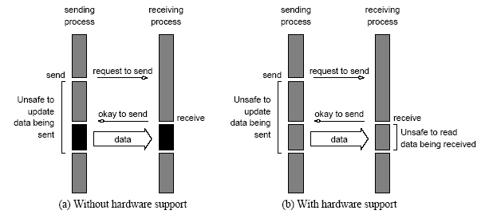
Non-Blocking Message Passing Operations
Non-blocking non-buffered send and receive operations (a) in
absence of communication hardware; (b) in presence of
communication hardware.

